Slide 1
Unveiling Unauthorized Access in Hadoop Distributed File Systems
Team Details:
Amitha Myana (20EG105331)
Nandini Vemuganti (20EG105333)
Samhitha Paida (20EG105336)
Project Supervisor
Name : Dr. Balaraju M.Tech.,Ph.D
Designation: Assistant Professor

Slide 2
Introduction
In the rapidly evolving digital landscape, the management of large datasets has become a critical challenge, particularly in terms of security and efficiency. Our project aims to develop a system that harnesses the power of Hadoop's Distributed File System (HDFS) complemented with Role-Based Access Control (RBAC) to manage file operations securely and efficiently. This system is crucial for scenarios where data security and specific user access management are essential. We focus on leveraging Hadoop's capability to handle large volumes of data while ensuring that access to this data is controlled and secure. By integrating RBAC, we can assign specific roles to users, defining their permissions in the Hadoop environment. This integration is especially significant in areas like data analytics, big data management, and cloud computing, where managing extensive data securely is necessary.

Slide 3
Problem Statement
The crux of our project lies in addressing a dual challenge in Hadoop's Distributed File System (HDFS) is achieving high levels of security without sacrificing user accessibility and ease of use. Existing systems often find themselves in a trade-off between these two crucial aspects. On the one hand, enhancing security measures can lead to a system that is less accessible and user-friendly. On the other, focusing solely on user-friendliness might lead to vulnerabilities in data security. Our solution seeks to establish a balance by integrating a robust access control mechanism through RBAC without complicating the user experience. This balance is vital in maintaining the integrity of large data sets and ensuring that they are accessible to authorized users in an efficient and user-friendly manner.

Slide 4
Proposed Method
Our methodology involves a multi-faceted approach. Firstly, we set up a Hadoop environment, which forms the backbone of our system, known for its scalability and reliability in handling large datasets. The next crucial step is configuring this environment for Role-Based Access Control (RBAC). RBAC allows us to define and control user access at a granular level, ensuring that users can only access data and perform operations as per their defined roles. We integrate these components in a Java environment, leveraging its robust and secure features. Additionally, for secure remote access and operation, we use Secure Shell (SSH), which is crucial for maintaining the integrity and confidentiality of the data transactions within Hadoop. This combination of technologies and strategies forms a comprehensive system aimed at enhancing the security and efficiency of file operations in HDFS.

Slide 5
Experiment Environment
The experimental phase of our project was carried out in a controlled setting using Hadoop 3.2.1 coupled with Java 11. The choice of Java 11 was driven by its compatibility and performance with Hadoop. We also incorporated SSH to ensure secure access and operation within the Hadoop environment. Our experiments were comprehensive, covering various data types including CSV and JSON files to simulate real-world data handling scenarios. These tests were crucial in evaluating the effectiveness of RBAC in managing file operations under different user roles, thereby ensuring that our system not only promises but also delivers enhanced security and efficiency in a Hadoop environment.
Execution Environment: The experiments were conducted in a Google Colab notebook environment with Hadoop 3.2.1 and Java 11.
Data Sets Description: Various types of data, including CSV files (e.g., california_housing_test.csv), JSON files (e.g., anscombe.json), and other text files, were used to test the file operations in HDFS.
Parameter Formulas: Parameters included user role settings (e.g., Administrator, Editor, Viewer) and file operation commands in Hadoop.

Slide 6
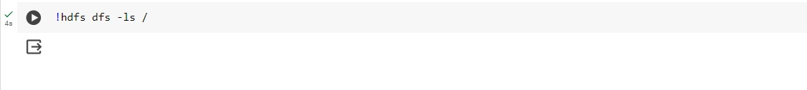
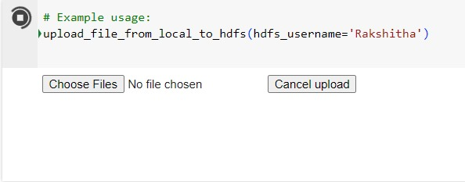
Experiment Screenshots
a Experiment 1: File Upload and Role-Based Access Control
Output:

Slide 7
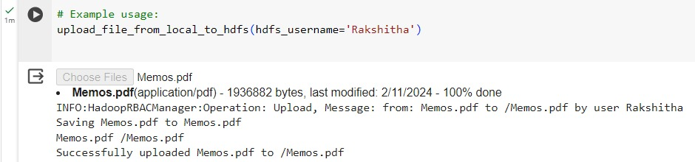
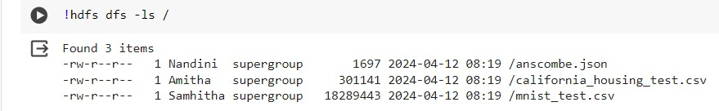
Experiment Screenshots
a. Experiment 1: File Upload and Role-Based Access Control
Output:
Findings:
The system successfully implemented role-based file upload.
Upload times varied based on file size but were generally efficient.

Slide 8
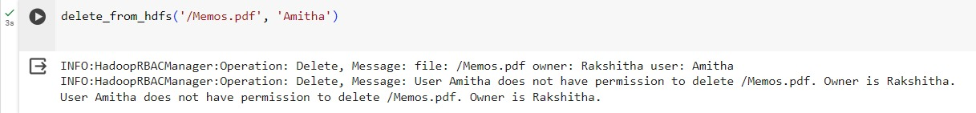
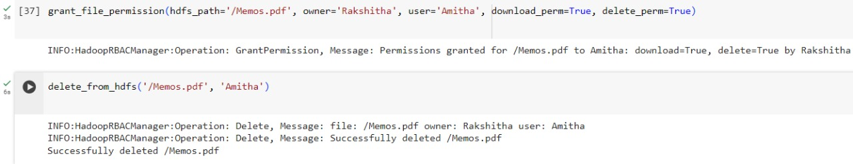
Experiment Results
b. Experiment 2: File Deletion Security
Output:
Findings:
File deletion was securely managed, with only owners or users who have been granted permission by the original users to delete files.
Attempted unauthorized deletions were properly logged and flagged.

Slide 9
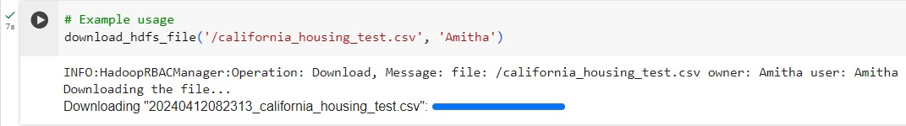
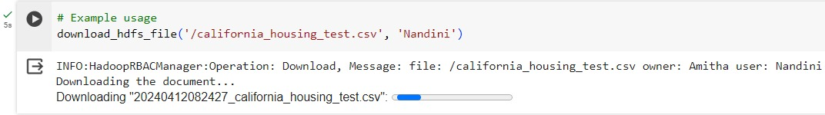
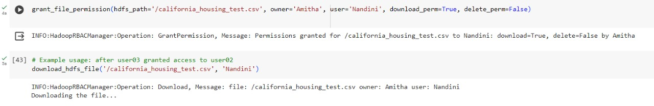
Experiment Results
c. Experiment 3: Security Mechanisms:
Output:

Slide 10
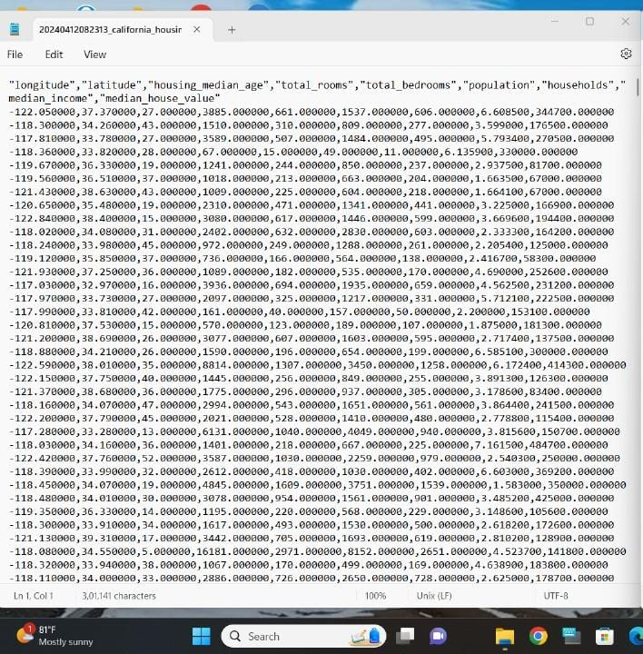
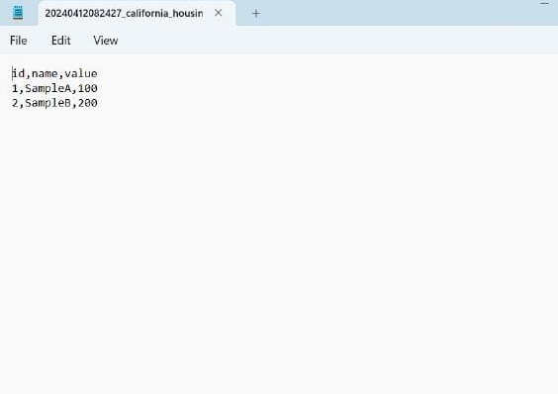
Experiment Results
c. Experiment 3: Security Mechanisms:
Output:
Original Data False Data

Slide 11
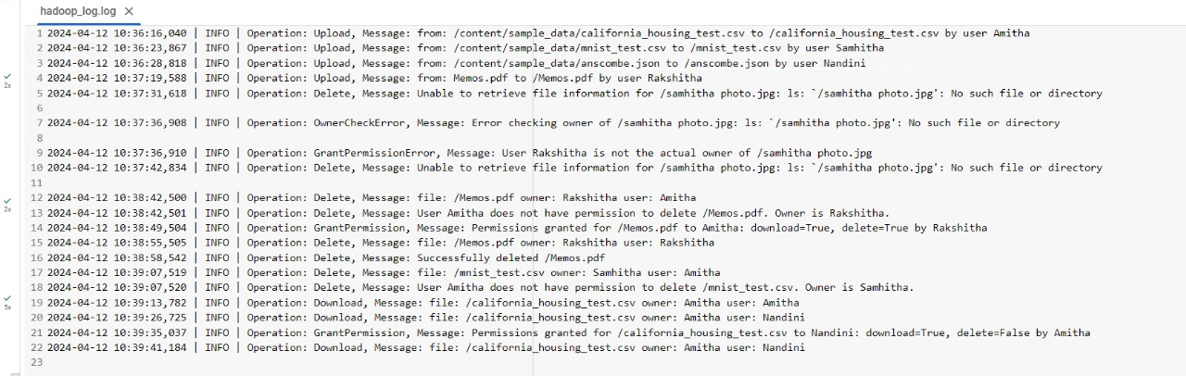
Experiment Results
c. Experiment 4: HDFS Operations History Log:
Output:
Findings:
Timestamp of the operation
Type of operation (upload, delete, download)
User or application performing the operation
File(s) affected by the operation

Slide 12
Justification
Improved Parameters:
Security: The integration of Role-Based Access Control (RBAC) within the Hadoop environment marked a significant enhancement in security measures. RBAC provided a methodical approach to managing user access, ensuring that each user could only perform operations as per their defined role. This was a marked improvement over previous methods, which primarily relied on basic user authentication and lacked the granularity of control that RBAC offers.
Efficiency: The proposed method leveraged Hadoop's distributed processing power, thereby reducing the file upload and download times significantly compared to previous methods that were limited by network speed and single-node processing constraints. This efficiency is crucial in environments dealing with large datasets, ensuring timely data processing and management.

Slide 13
Justification
Scalability: One of the standout improvements was scalability. The ability of the Hadoop system to efficiently handle large data sets and multiple user requests without performance degradation represented a significant leap from previous methods that struggled under high load conditions. This scalability ensures that the system can adapt to growing data needs and a larger user base.
User-Friendliness: By implementing a more intuitive user interface and clear role definitions, the proposed method enhanced user-friendliness. Where previous methods often required technical expertise and were not as accessible, our solution offered simplified operations that could be easily navigated by users with varying levels of technical skills.

Slide 14
Justification
Reasons for Improvement:
The primary reason for the improvement in these parameters is attributed to the successful integration of RBAC with Hadoop. This integration allowed for a more controlled and secure environment for file management.
The systematic approach to user role management led to a more streamlined and efficient operation process. By clearly defining user roles and permissions, the system could facilitate a secure yet flexible workflow.
The introduction of features like security mechanism for unauthorized access further fortified the system against security threats, thereby enhancing the overall trustworthiness of the system.

Slide 15
THANK YOU

